Slide 1
Catheter Placement
Group 3

Slide 2
Introduction

Slide 3
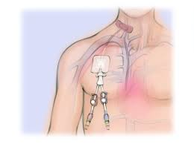
Background
Tubes inserted into the body for various medical purposes
COVID-19, coronary artery disease, chest pain
Correct placement is crucial

Slide 4
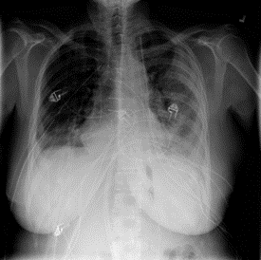
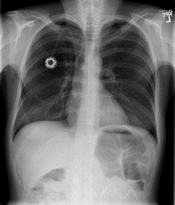
The dataset
ETT (Endotracheal Tube)
NGT (Nasogastric Tube)
CVC (Central Venous Catheter)
Swan Ganz Catheter
Normal
Borderline
Abnormal

Slide 5
Research questions
Can we identify patterns in positioning status
Which catheter types are more prone to misplacement?
Can we create models to help doctors identify incorrect catheters?
Which machine learning model is most effective in predicting catheter placement status?

Slide 6
Data Preprocessing

Slide 7
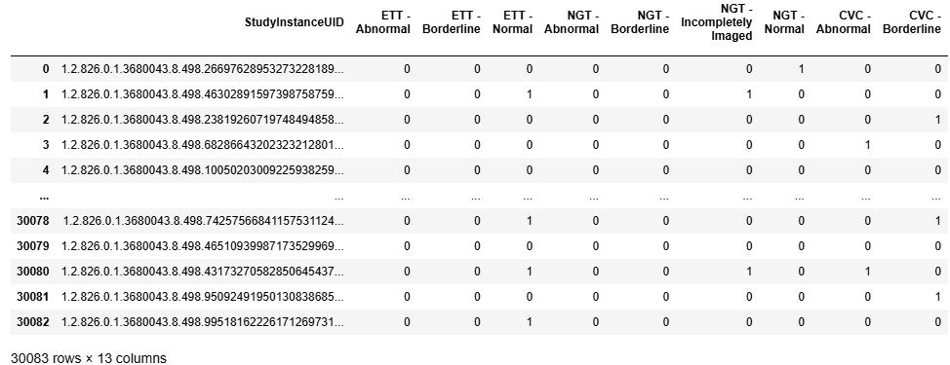
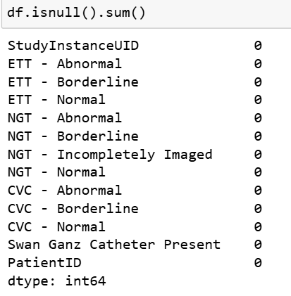
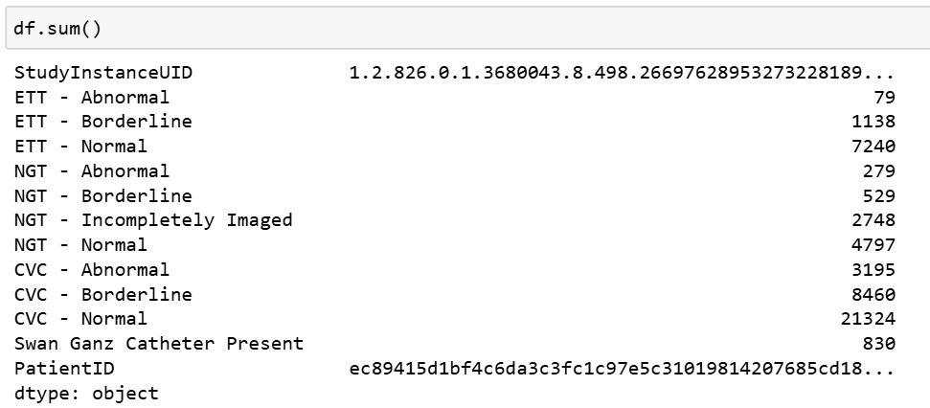

Slide 8
Exploratory Data Analysis

Slide 9
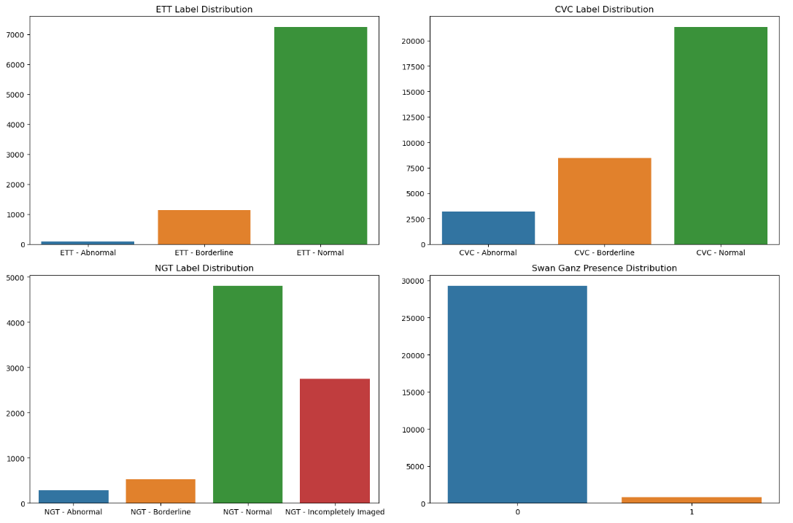
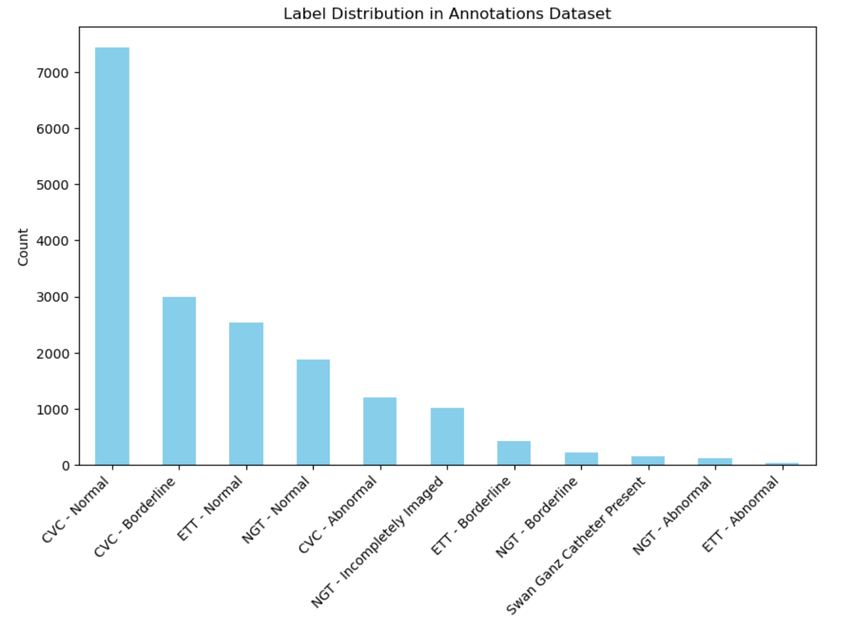
What are the overall distributions of catheter placement statuses across different catheter types?

Slide 10
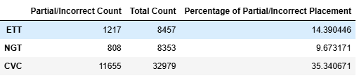
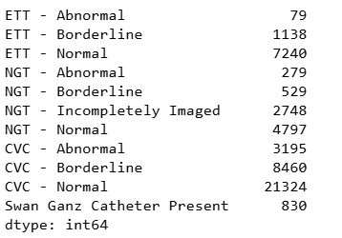
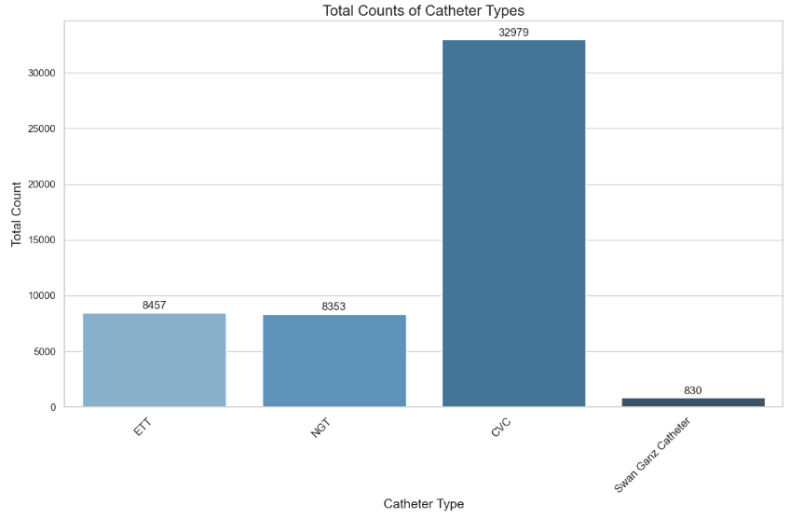
How does the frequency of normal, borderline, and abnormal placements differ among the different types of catheters (ETT, NGT, CVC)

Slide 11
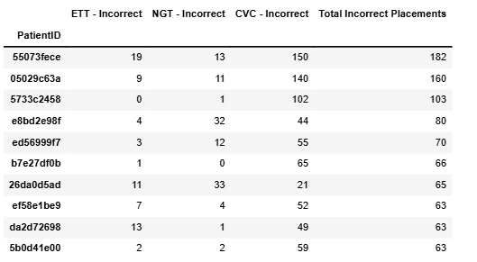
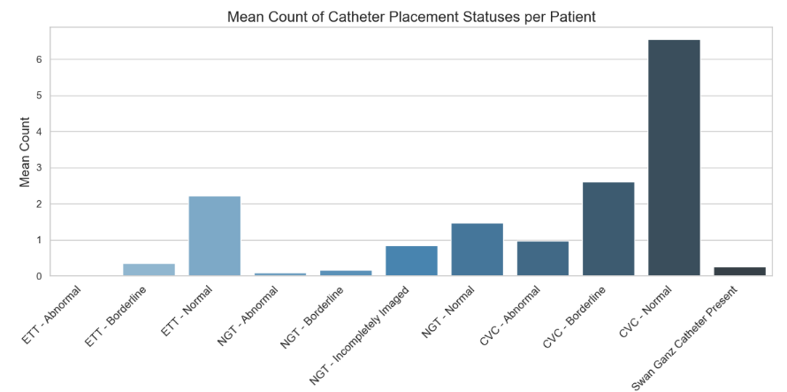
How many unique patients are in the dataset, and how are catheter placement statuses distributed across these patients?

Slide 12
Annotation to image

Slide 13
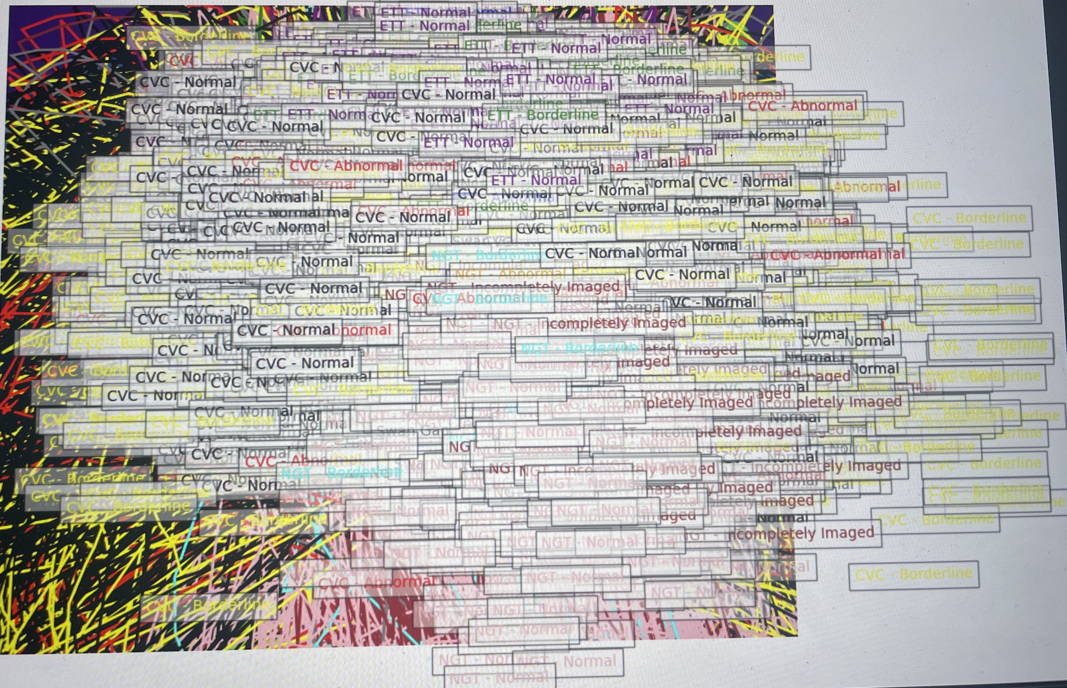
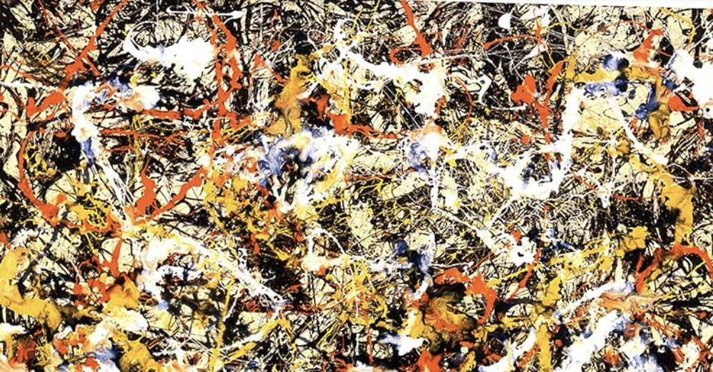
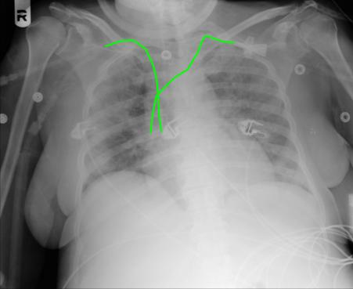
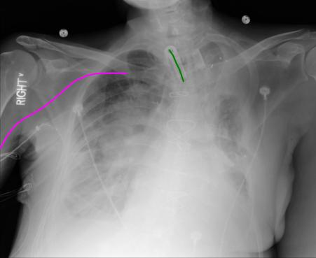
Used this new annotated image dataset for UNET model
Helps as well for cather visualisation

Slide 14
Data Modelling

Slide 15
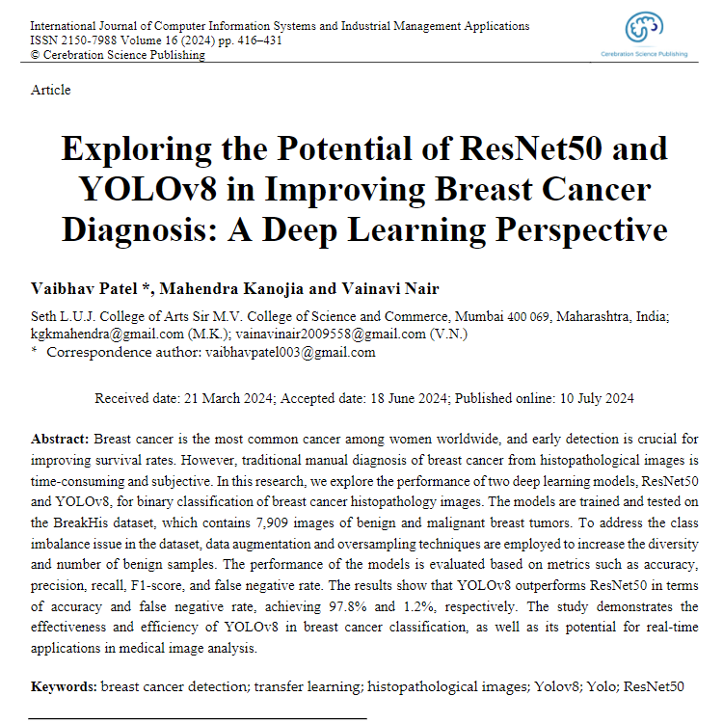
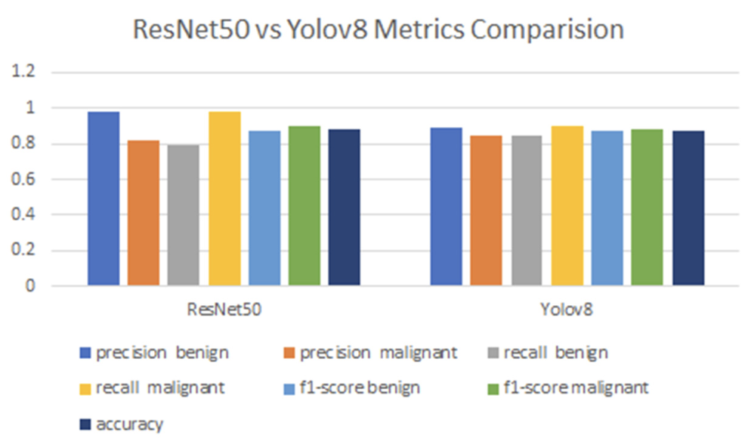
Selecting a model and Preparing the data
Contention: Test whether we can predict if a catheters placement is correct or incorrect
Researched popular CNN used in the medical field
Firstly, we labeled all the catheters as normal if they were placed correctly and not_normal if they were abnormal or partially correct
Split into a train 70%, test 20%, validate %10
An initial problem found with the models is that a large portion of time was spent resizing images during the training process. Since each image is used more than once in the training, therefore resized multiple times, it saves time to have the images in the correct size before training
“Power toys: image resizer utility’

Slide 16
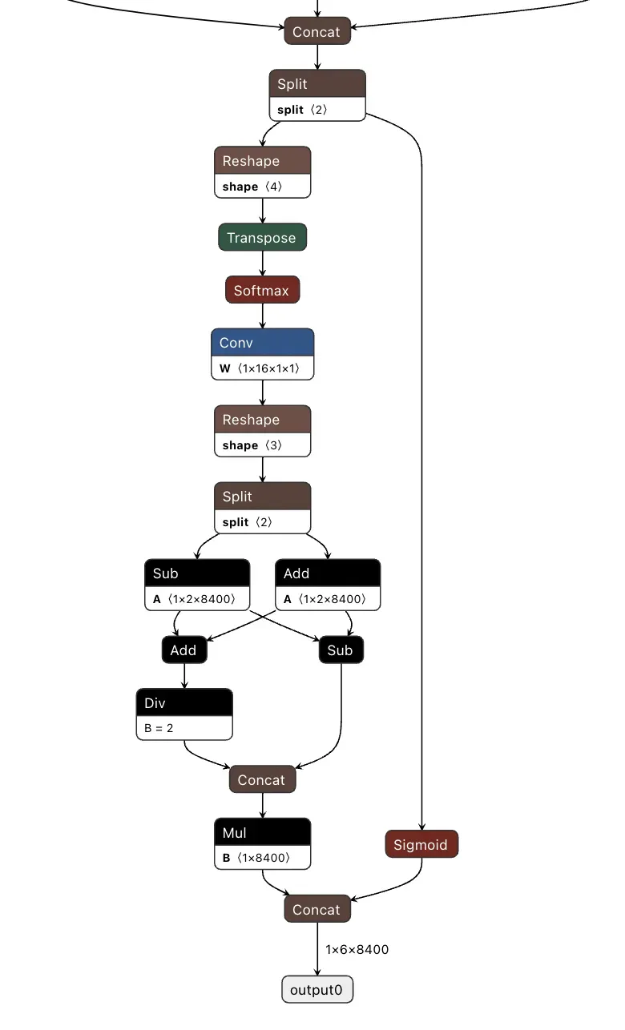
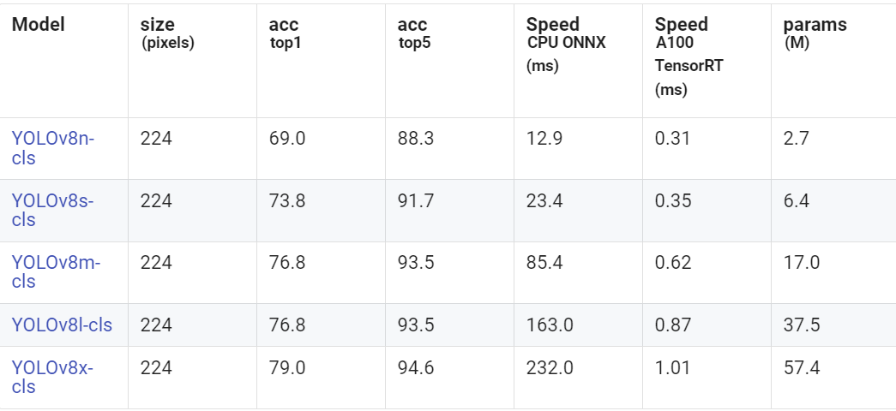
Yolov8-cls
Yolo is known for its object detection, however it has classification models
Yolov8-cls has 5 possible models, we will use small, medium and large
Yolo is a CNN, specifically CSPDarknet53
Cross stage partial networks: splitting feature map into 2
Improves the speed of the network (great for real time implementation)
Vanishing gradient problem

Slide 17
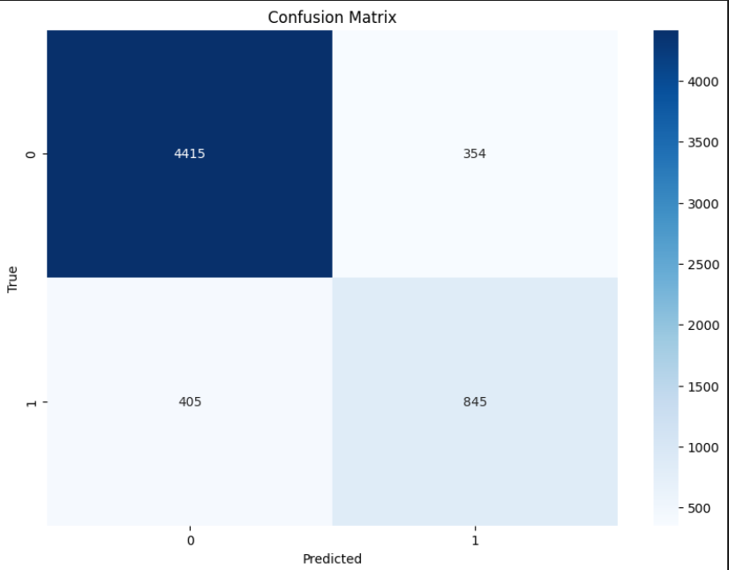
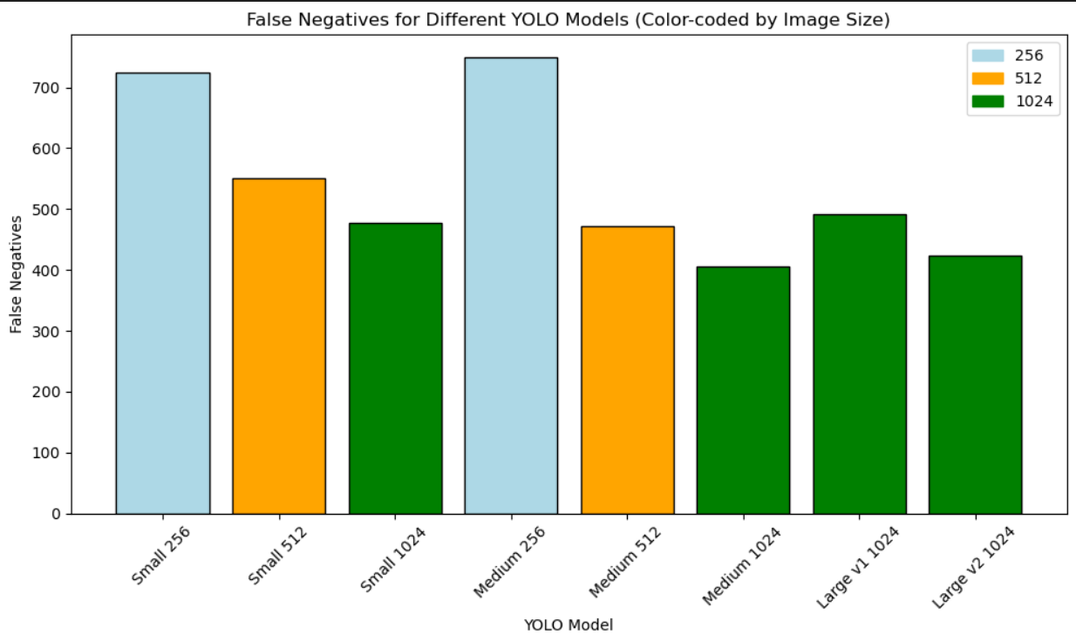
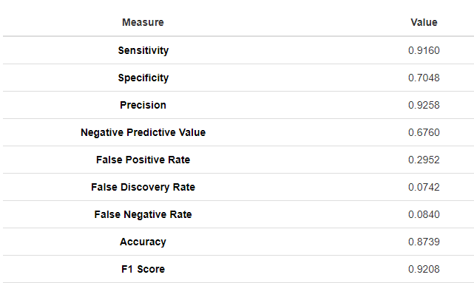
Results of initial Yolov8-cls
Want to limit false negatives
We can test the yolo models on different sizes of images
The greater the image size, the more detail, and the less false negatives that occur
On average the small model did the worst, and then the large
The medium model with 1024 pixel size did the best with only 405 of the incorrect catheter being labelled as correct. However this is only 67.6% of incorrect catheters being identified

Slide 18
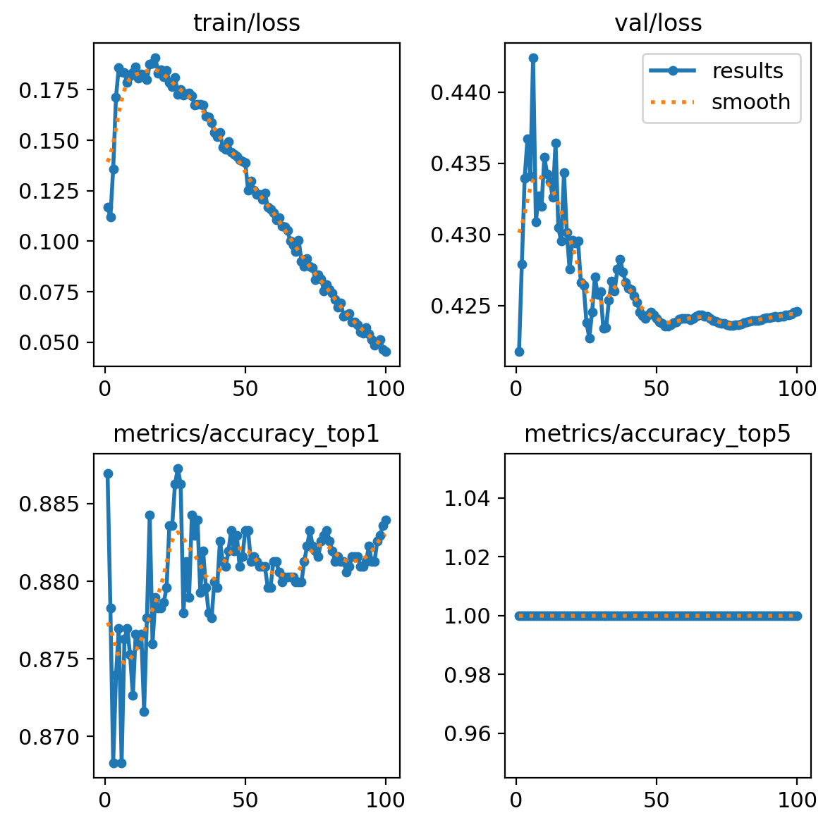
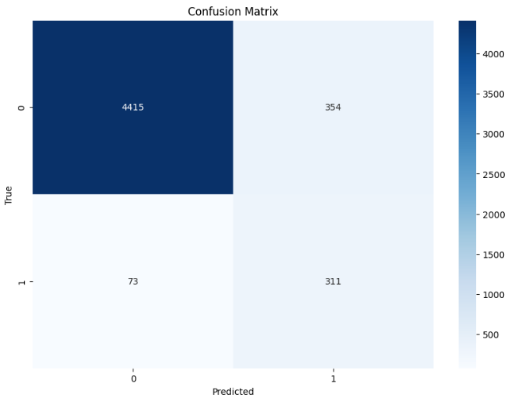
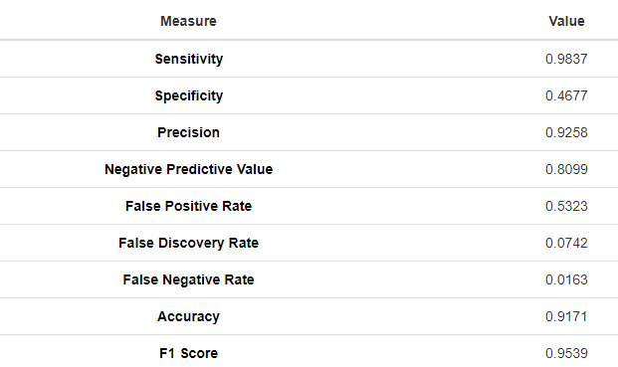
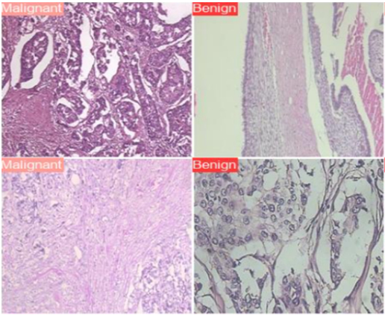
Yolov8-cls Continued
To further analyse the model and where it is possibly going wrong, we can investigate on how the models trained and the testing
Large models worse than medium?
Large models struggled to train, overfitting
Can limit the testing data to only the catheters that are completely wrong
This performs much better, meaning that the models struggles with the partially placed catheters
Comparing to the original breast cancer diagnosis, that we decided to use Yolo based on, there are some big differences between the types of images
Training of large model

Slide 19
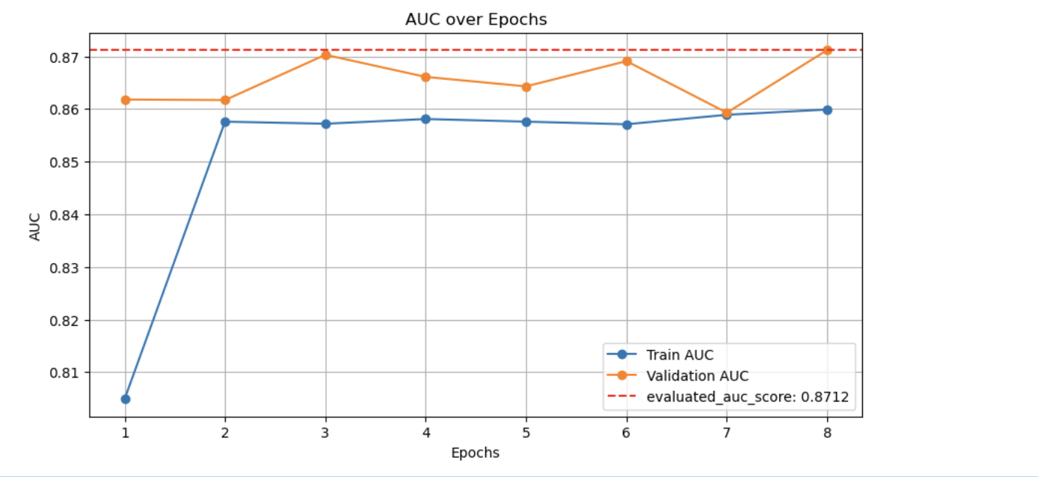
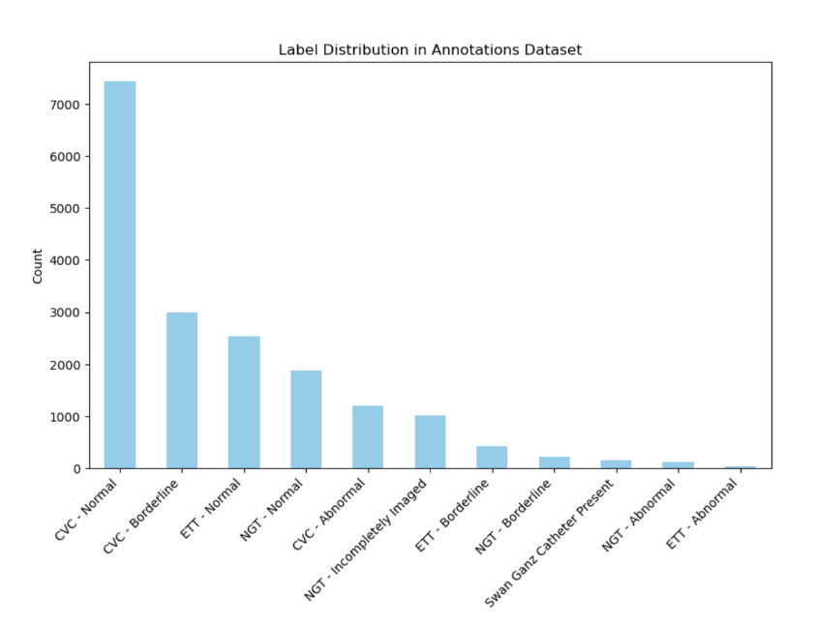
RESNET
Why ResNet: excels at image classification tasks and handles vanishing gradients better due to its residual connections
Why do we use AUC: better for data with class imbalance (Using AUC and Accuracy in Evaluating Learning Algorithms, Jin Huang and Charles Ling, March 2005).
and in medical scenarios, false positives and false negatives can have very different consequences. For instance, a false negative (predicting a wrong placement as correct) can be far more dangerous than a false positive (predicting a correct placement as wrong).In medical applications, it’s essential to ensure the model is not just "right" most of the time (which accuracy measures), but that it can confidently distinguish between correct and incorrect outcomes (which AUC measures).

Slide 20
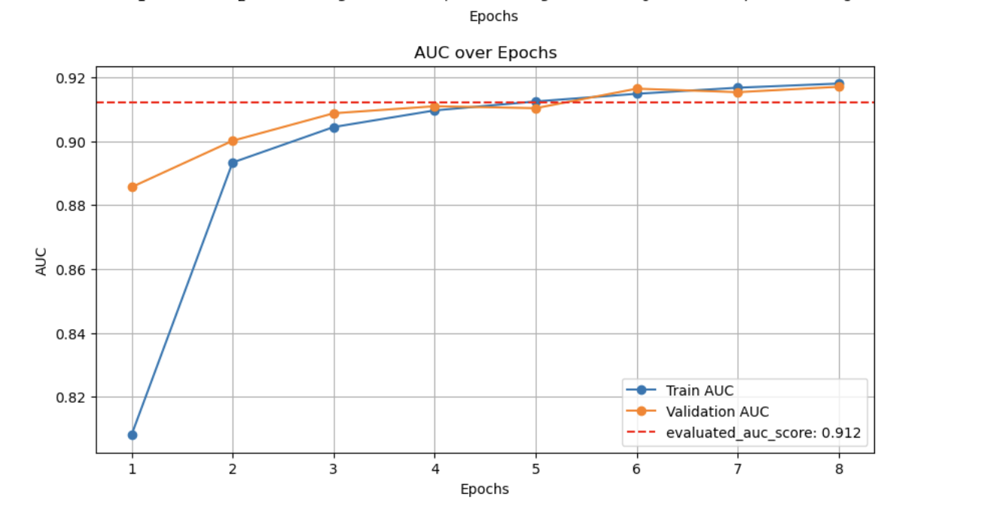
DENSENET

Slide 21
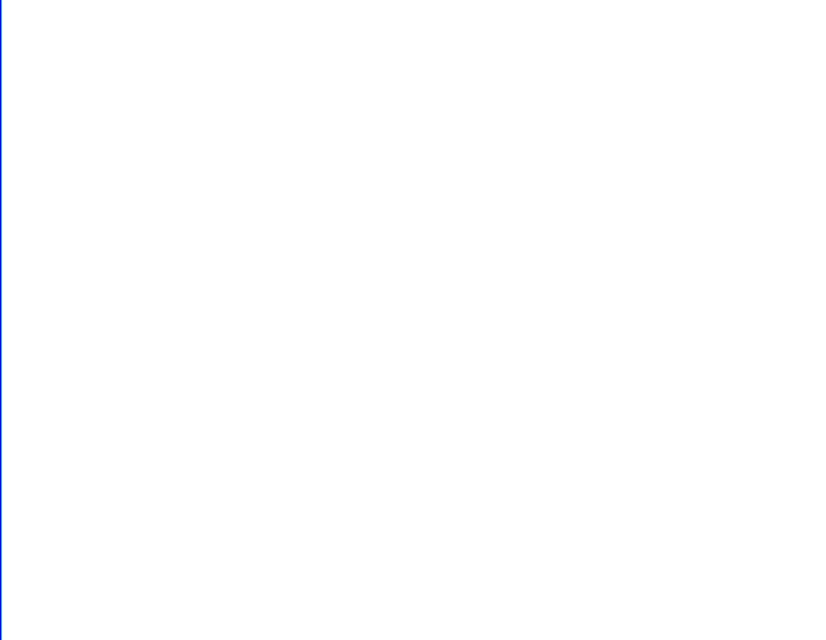
UNet for segmentation
Answer a question:
We used ResNet and Yolo models, what other models can help us with further analysis?
Purpose:
We use Unet's image segmentation function to find the baselines with important coordinates in the x-ray.

Slide 22
Why Unet is important and why we use it
Importance:
Precise Segmentation: Excels at pixel-level predictions by capturing both global context and fine details.
Skip Connections: Preserve spatial information lost during downsampling, enhancing accuracy.
Efficiency with Limited Data: Performs well even with small datasets through effective data augmentation.
Versatility: Adaptable to various image processing tasks beyond its biomedical origins.
Pixel-wise Accuracy: Ideal for tasks requiring detailed localization within images.
Flexible Architecture: Fully convolutional network that handles images of varying sizes.
Robust Performance: Combines deep learning capabilities with the need for precise spatial information.

Slide 23
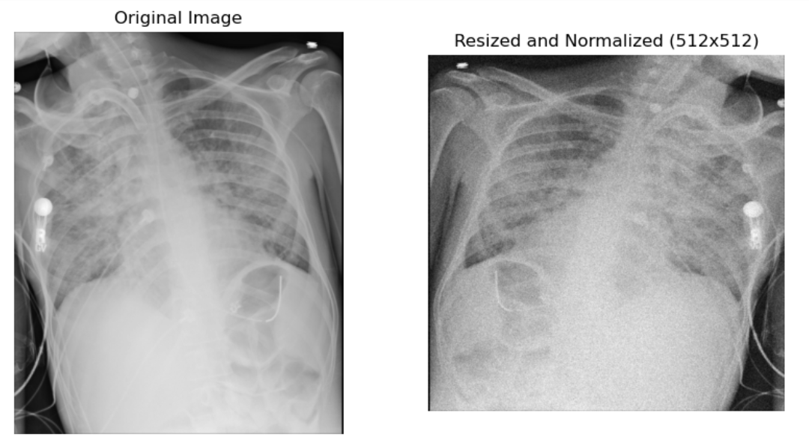
Preprocessing (512*512)
Each image is resized to 512x512 pixels
Augmentation (loop): horizontal flipping, adjusting brightness, contrast, adding noise
Mask Coordinates Adjustments
Saving and Normalizing Images
Notes:
I am going to explain how I used image preprocessing and augmentation techniques to prepare medical images for U-Net training.
the first step is, each image is resized to 512x512 pixels
To improve the model's generalization ability, I applied different augmentation techniques to the images. These included horizontal flipping, adjusting brightness and contrast, and adding noise. These augmentations simulate different real-world scenarios, such as lighting variations, which helps the model become more robust when predicting on new data.
Since each image has a corresponding mask that identifies important features, I also had to adjust the mask coordinates during resizing and augmentation. For instance, if an image is flipped horizontally, the corresponding coordinates need to be flipped too.
Once preprocessing is complete, I saved the modified images as .npy files. These files are easier to use during training. After loading the images and masks, I normalized them to improve the model training process.

Slide 24
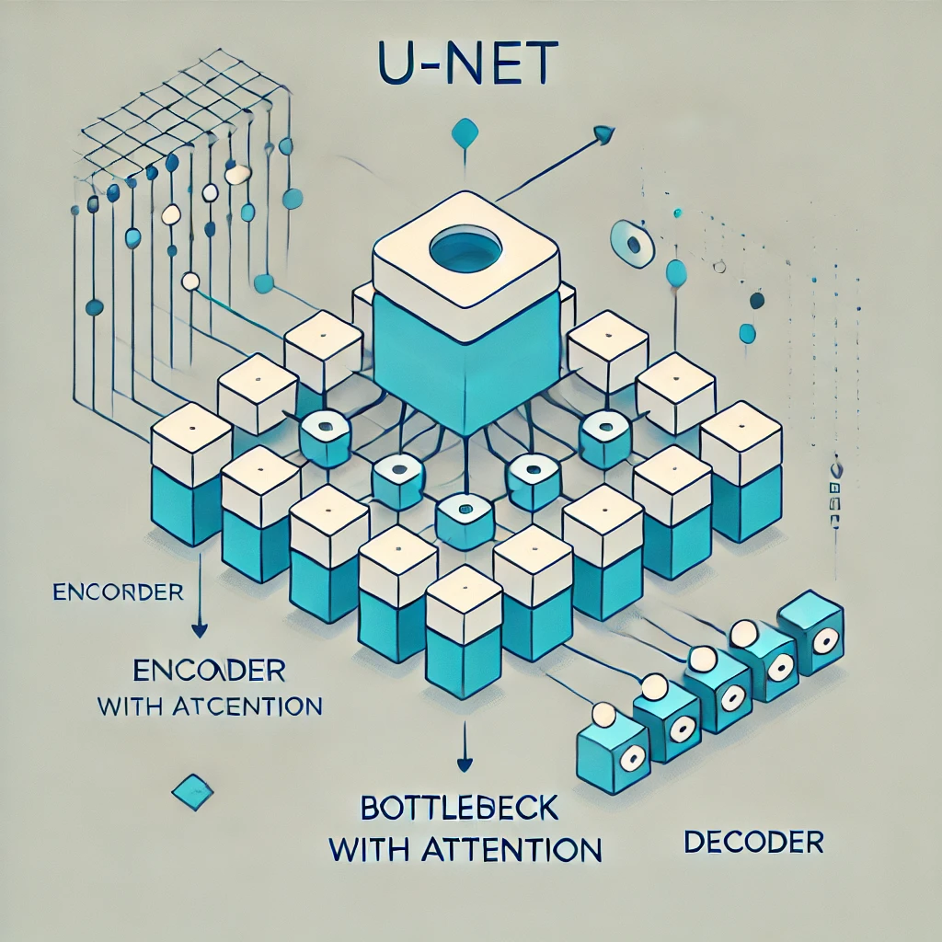
U-Net Model (512*512)
Splitting the Dataset (80%train, 20%test)
Building the U-Net Model with Space Attention
Compiling the Model with Advanced Loss Function a combination of binary cross-entropy and Dice loss
Training the Model with Early Stopping
Validation accuracy: 94% Validation loss: 0.27
Notes:
Training a U-Net Model with Attention Mechanism
First of all, I listed all input files and loaded each preprocessed image. For each image, I also generated a mask using the updated annotation data. The mask marks specific and important regions. To make the images and masks compatible with the U-Net model, I expanded their dimensions.
I then split the dataset into training and validation sets. 80% of the data was used for training, and the remaining 20% for validation.
And then, I built a Unet model with attention. The U-Net model consists of an encoder and a decoder, where the encoder extracts features at multiple levels of detail. By increasing the model depth, we capture more complex features, enabling better understanding of the image. The attention mechanism acts as a way for the model to prioritize certain parts of the image. The attention mechanism is integrated into the bottleneck layer, where it focuses on the most relevant features before passing the information to the decoder. The decoder then reconstructs the image while considering these highlighted features, making the model more effective at identifying complex patterns.
To compile the model, I used a combination of binary cross-entropy and Dice loss. Binary Cross-Entropy is used for general pixel-wise classification tasks, where each pixel is classified as either belonging to a region of interest or not.The Dice loss is particularly sensitive to small annotated regions, which helps improve the model's performance. This choice of loss function helps the model learn to focus on important small features.
Finally, I trained the model using an early stopping callback. This means that training stops when the validation loss stops improving for a certain number of epochs, preventing the model from overfitting.

Slide 25

Difference between 512*512 and 1024*1024
Vantage:
Higher resolution images catch more detail and detect smaller features or anomalies that may be missed at 512x512 resolution
Advantage:
Requires more memory, takes longer to compute

Slide 26
Conclusion

Slide 27
Overall results and limitations
Results:
We can detect 80% of false negatives using the Yolo model
UNET model had a validation accuracy of 94% to detect the catheters placement in the body
Using the resnet model, we had auc of 87% and Densnet had a even higher result at 91%
Improvements:
Computation error associated with Massive
Unet’s result could be input of resnet to get more accurate placement of the catheters

Slide 28
References
Vaibhav Patel, Mahendra Kanojia, & Vainavi Nair. (2024). Exploring the Potential of ResNet50 and YOLOv8 in Improving Breast Cancer Diagnosis: A Deep Learning Perspective . International Journal of Computer Information Systems and Industrial Management Applications, 16(3), 16. Retrieved from https://cspub-ijcisim.org/index.php/ijcisim/article/view/717

